Slide 1
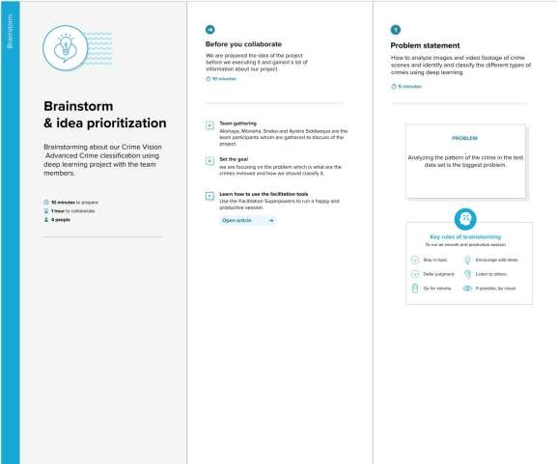
Ideation Phase Brainstorm & Idea Prioritization
Date | 24 May 2023
Team ID | NM2023TMID11394
Project Name | Gas Pipeline Monitoring System For Hospitals
Brainstorm & Idea Prioritization Template:
We are brainstormed by analyzing the pattern to identify the different types of crime. The patterns may be the fatal or non-fatal weapon, situations and environment, positions of the non-fatal weapons, objects involved in the crime and the person involved in the images orGas Pipeline Monitoring System For Hospitals
Step-1: Team Gathering, Collaboration and Select the Problem Statement

Slide 2
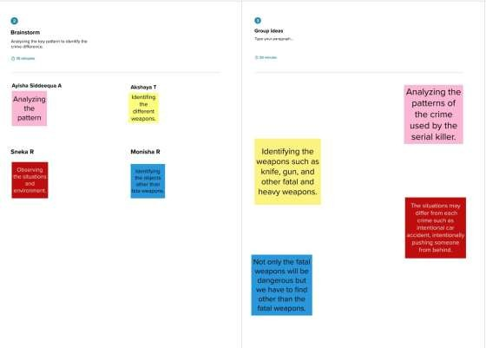
Step-2: Brainstorm, Idea Listing and Grouping
Step-3: Idea Prioritization

Slide 3
